Slide 1

Clean Code
Agile Software Craftmanship
By Vinanti Thakur (Tech. Architect)
November 21, 2019

Slide 2
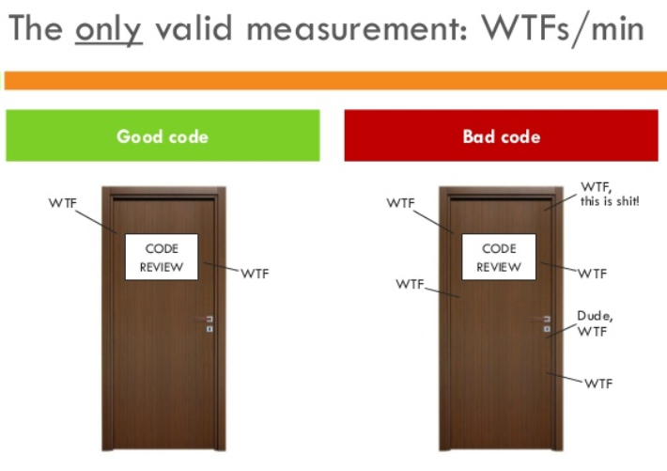
Introduction
Writing clean code is what you must do in order to call yourself a professional.
Clean code is subjective and every developer has a personal take on it.
There are some ideas that are considered best practice and what constitutes as clean code.
21 November 2019

Slide 3
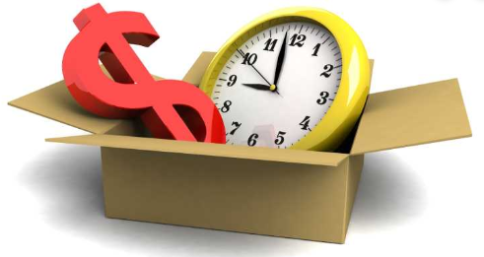
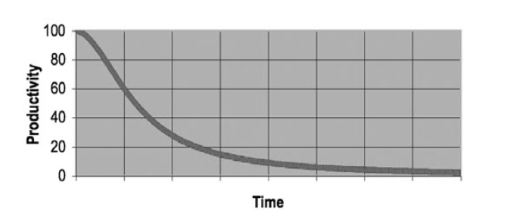
Why Clean Code..??
Reason 1: you are a Programmer.
Reason 2: you want to be a Better Programmer.
The Total cost if Owning a Mess!
21 November 2019

Slide 4
Goal: Code must be…
Readable
Maintainable
Extendable
Testable
21 November 2019

Slide 5
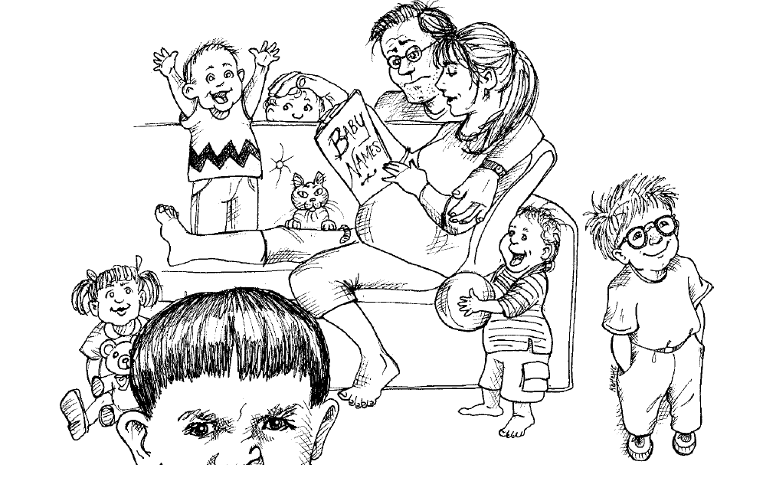
Meaningful Name
Naming Convention is an important in Architecture Modeling.
A naming convention is a set of rules for choosing the names which denote variables, types, functions, and other entities in your code.
Standard naming system must be define in Architectural/coding Document and set as standard.
21 November 2019

Slide 6
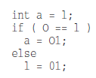


Meaningful Name
1. Use Intention- Revealing Name | 2. Avoid Disinformation
int d; //elapsed time in days Int elapsedeTimeInDays;
3. Make Meaningful Distinctions | 4. Use Pronounceable Names
5. Use Searchable Names | 6. Avoid Encoding
 | Hungarian Notation Member Prefixes Interfaces and Implementation
21 November 2019

Slide 7
Meaningful Name
7. Avoid Mental MappingAvoid Mental Mapping | 8. Class Names
9. Method names | 10. Don’t Be Cute
11. Pick One Word per Concept | 12. Don’t Pun
21 November 2019

Slide 8
Meaningful Name
13. Use Solution Domain Names | 14. User Problem Domain Names
15. Add Meaningful Context | 16. Don’t Add Gratuitous Context
21 November 2019

Slide 9
Functions
21 November 2019

Slide 10
Comments
21 November 2019

Slide 11
Formatting
21 November 2019

Slide 12
Object and data structure
21 November 2019

Slide 13
Error Handling
21 November 2019

Slide 14
Boundaries
21 November 2019

Slide 15
Unit Test
21 November 2019

Slide 16
Classes
21 November 2019

Slide 17
Systems
21 November 2019

Slide 18
Emergence
21 November 2019

Slide 19
Concurrency
21 November 2019

Slide 20

Thank You!!!
21 November 2019

